Slide 1

IBM Capstone Project
Road Accident Severity Prediction Model

Slide 2
The purpose of this project is to create a machine learning model that predicts the severity of road accidents based on the road conditions and weather conditions.
The shared dataset is from Seattle city.

Slide 3
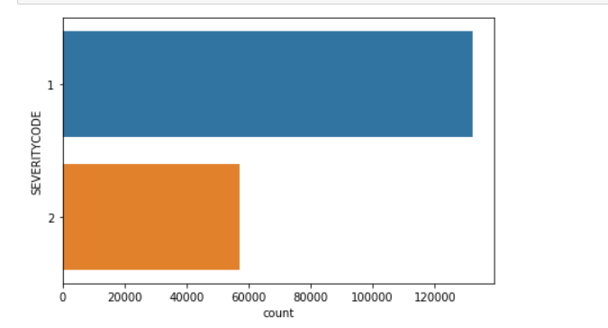
There were a greater number of accidents of severity code 1.

Slide 4
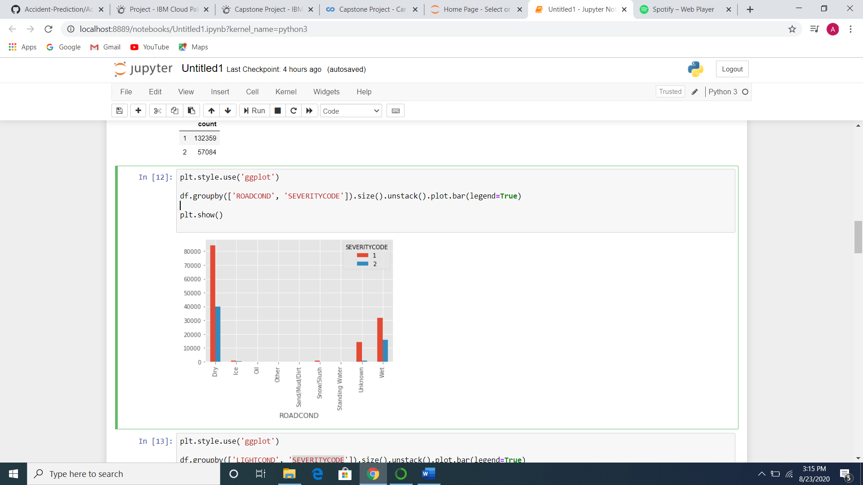
Dry and Wet road conditions caused the greatest number of accidents.

Slide 5
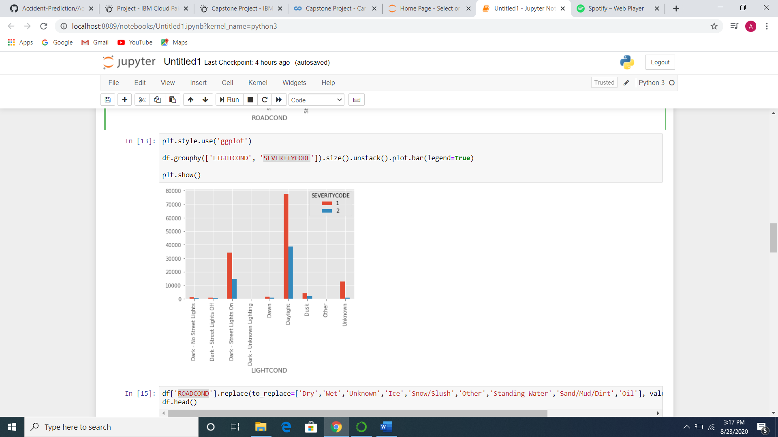
Most accidents were caused during Daylight and in the Dark-Street Lights On

Slide 6
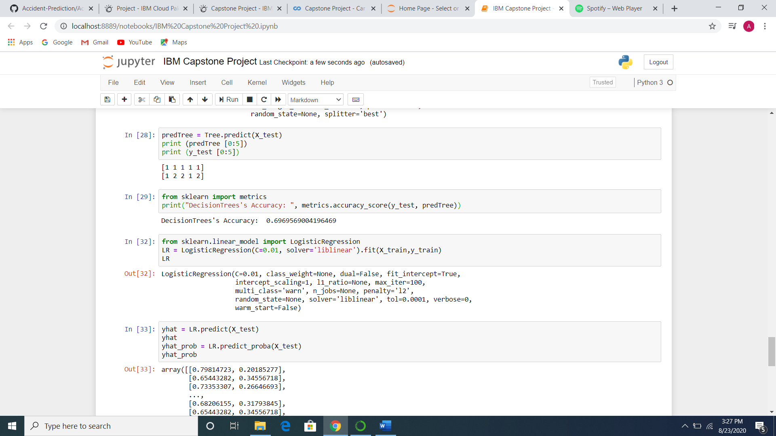
Using Decision Tree to predict accuracy of road accident severity

Slide 7
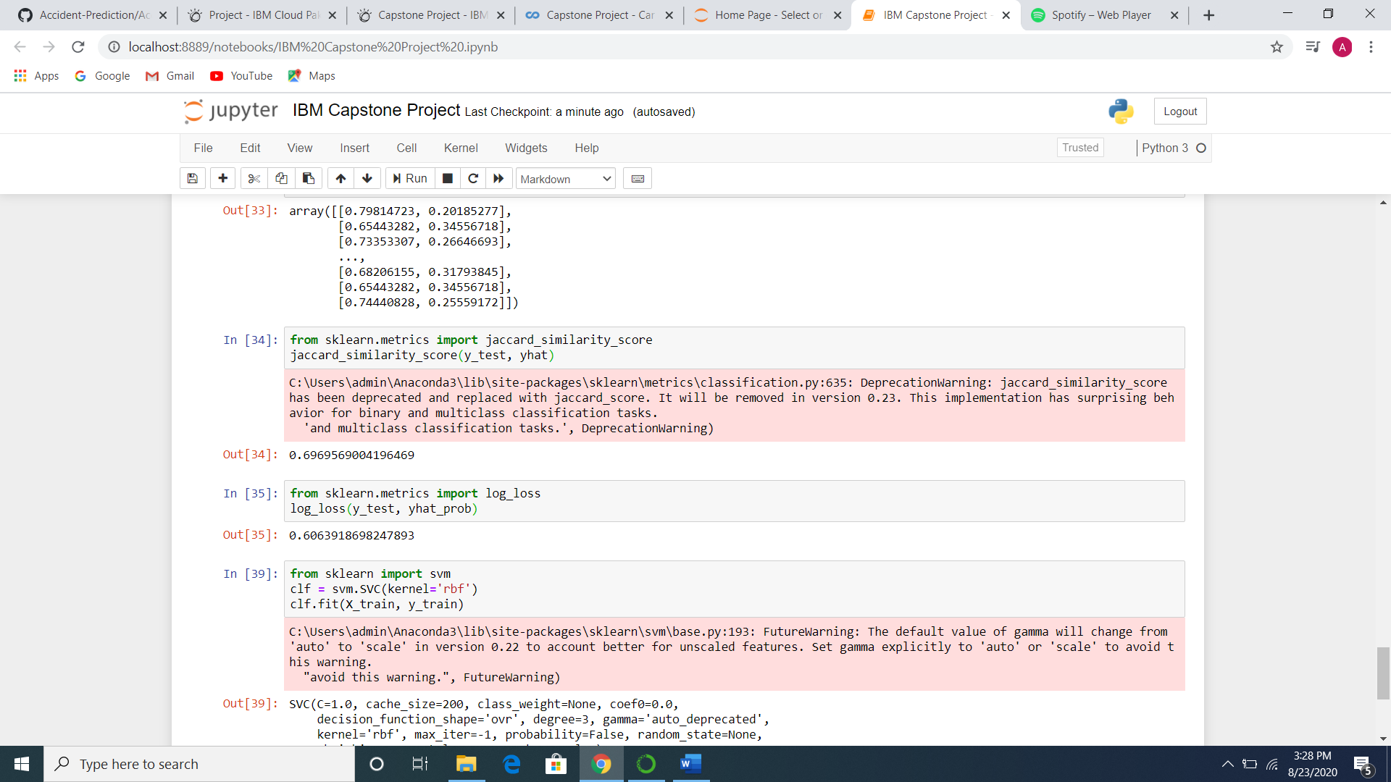
Using Logistic Regression to predict accuracy of road accident severity

Slide 8
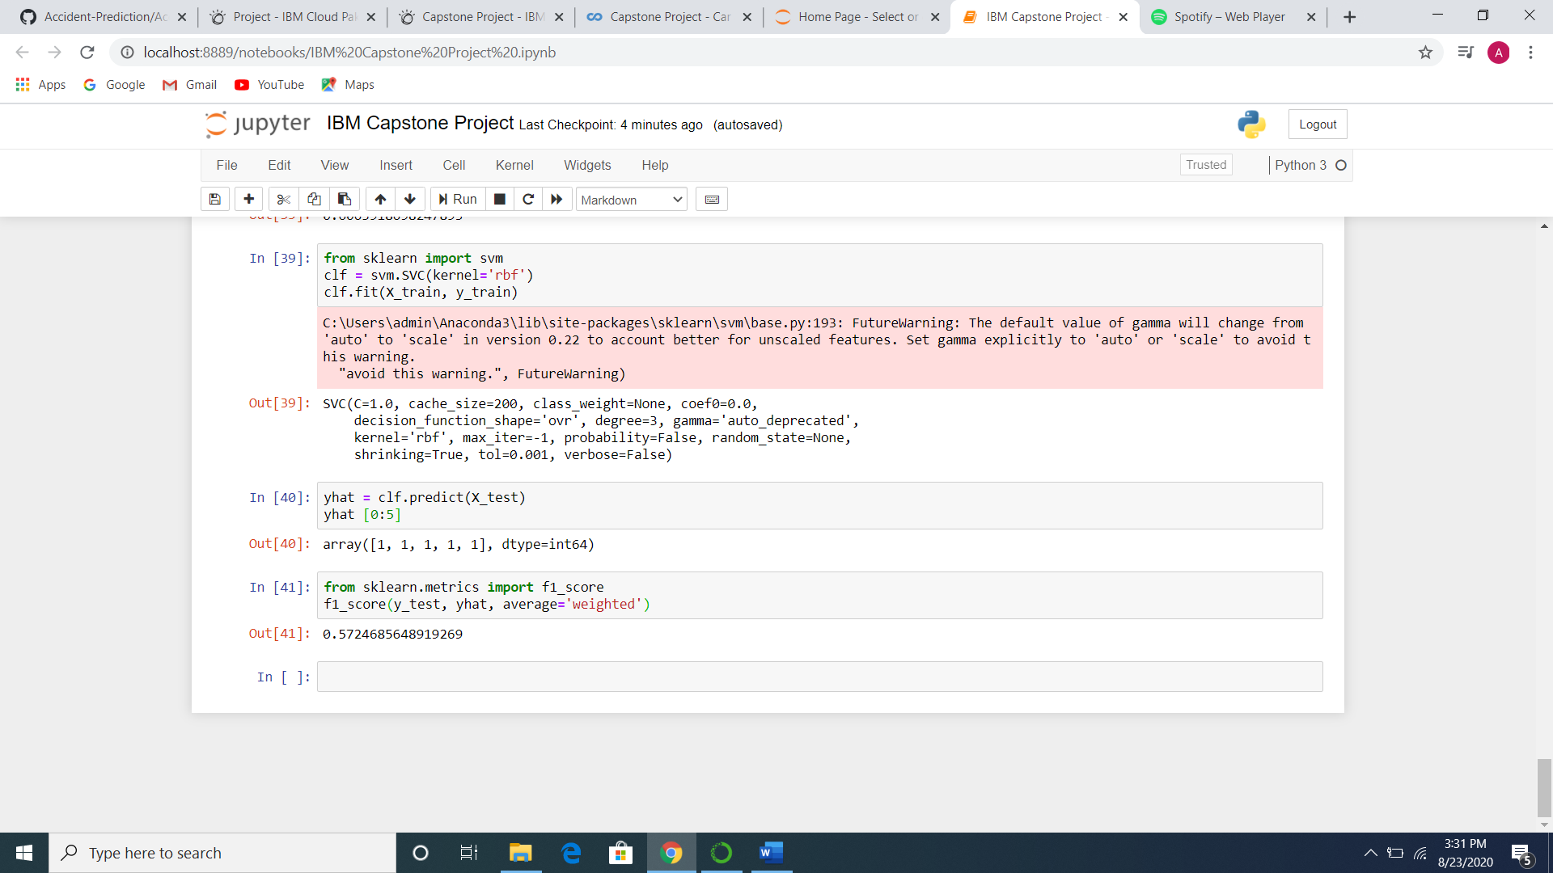
Using Support Vector Machine to predict accuracy of road accident severity

Slide 9
Decision Tree and Logistic Regression models gave an accuracy of ~69%. These models maybe used to predict the severity of the road accidents based on road conditions.
It is recommended that car travel be avoided during wet and snowy weather conditions.

